Slide 1
Concentric Map Review
Biofield Implications
Presented by Kate Shelest RN BSN CAIEHP™
January 2016 Langara College AIEH Program™
© Kate Shelest RN BSN CAIEHP™

Slide 2
INTRODUCTION
INTENTION: To …
provide a brief overview of the Integral Concentric Map
review the Physical, Emotional, Mental and Spiritual ‘subliminal consciousness’’
provide examples of how these may manifest in our Clients.
OUTCOMES: You will …
have a better understanding of the Integral Concentric Map
be better able to identify manifestations of Physical, Emotional, Mental and Spiritual Consciousness and their impact on each other & your Client
© Kate Shelest RN BSN CAIEHP™

Slide 3
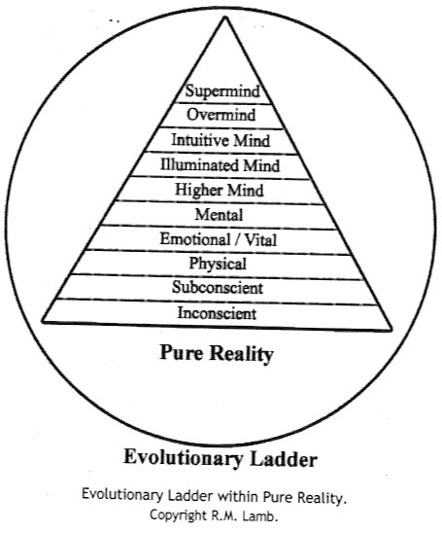
Evolutionary Ladder of Consciousness
Hierarchical, vertical planes of Being transcend from Low to High vibrational status
Progress through this ladder is impacted by Involution & Evolution
May become ‘stuck’ on levels unable to progress and achieve balance, especially Lower levels
Refer to Lamb, Chapter 2 ‘Human Becoming’
© Kate Shelest RN BSN CAIEHP™

Slide 4
INTEGRAL CONCENTRIC MAP
The Concentric Map represents:
the relationship between the inner Physical, Emotional, Mental & Innermost Being/Soul Self
The relationship is not Linear > it is a multidimensional Matrix
‘this Inner Being knows much that is unknown to the outer being because it is in direct contact with the secret forces of Nature’
            Sri Auro Bindo (Lamb 2012)
© Kate Shelest RN BSN CAIEHP™

Slide 5
VERY SIMPLY PUT …
Physical
  The ‘mind’ of the cells
  First to evolve
  Habitual and mechanical Somatic symptoms
Emotional Vital
  Lower and higher
  Dynamic
  Subjective & Emotive
  Ego-centric (pre-Egoic/Egoic/ beyond Ego consciousness)
Mental
  Cognition
  Rationality/Intelligence
  Thought patterns
  The ‘Witness’
Spiritual
  Soul-self awareness
  Spiritual connection/foundation
  Values, Morals & Truth seeking
© Kate Shelest RN BSN CAIEHP™

Slide 6

HOW THEY IMPACT EACH OTHER
Which dominates
Which shrinks to the background
  Tamasic vs Rajasic
  Is there balance > Sattvic
How is the client impacted
Is your client aware
? WHAT DO YOU NOTICE ?
© Kate Shelest RN BSN CAIEHP™

Slide 7
What We May Notice …
PHYSICAL
  ^Somatic Symptoms
  Pain
  Fatigue
  Disease Process
EMOTIONAL VITAL
  Emotionally Labile
  Fear
  Anxiety/Depression
  Agitation
MENTAL
  Scattered thoughts
  No Insight
  Negative Thought Patterns
  No ‘Witness’
SPIRITUAL
  Loss of Faith/Seeking
  Loss of Sense of Belonging
  No Moral Compass
  Lost Sense of Self
© Kate Shelest RN BSN CAIEHP™

Slide 8
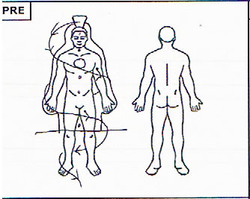
Example: Rajasic Spiritual Consciousness
7th Chakra dominant/solid/reaching
4th Chakra vaguely energetic
Remaining Chakras ‘shrunken’
Dense energy sensed only in 2nd layer, from crown to knees.
No energy sensed from knees to feet
Line of energy ‘corkscrewing’ from crown around physical body and draining to ground.
© Kate Shelest RN BSN CAIEHP™

Slide 9
WHY IS THIS IMPORTANT?
The Concentric Map view provides us with a template to better understand what is happening on a Consciousness level with our clients
The Concentric Map view provides us with a richer understanding of an Integrated Whole Being state. It provides information for us to delve deeper if we wish.
The Concentric Map provides clues to Consciousness in relation to what we know of the Biofield, the Chakras and the Layers.
The Concentric Map provides a template to choose appropriate & measure response to AIEH™ treatments.
© Kate Shelest RN BSN CAIEHP™

Slide 10
CONCLUSION:
Start with the basics
Notice:
The Physical, Emotional-vital, Mental and Spiritual consciousness
Notice:
How each manifest, influence and interact with each other
Notice:
How each might relate to areas of the Biofield
Notice:
How each respond to the AIEH™ treatments and co-created learning activities
© Kate Shelest RN BSN CAIEHP™

Slide 11
Reference
Lamb, R.M. (2012). Human becoming. A guide to soul centered living. Vancouver, BC: Cittam Futures Inc.
© Kate Shelest RN BSN CAIEHP™

