Slide 1
Holistic Nursing
What Is It
&
Why Does It Matter??
KShelest/KDerkach 2024

Slide 2
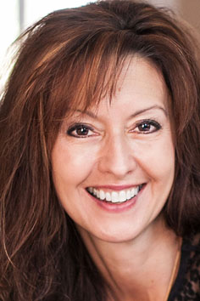
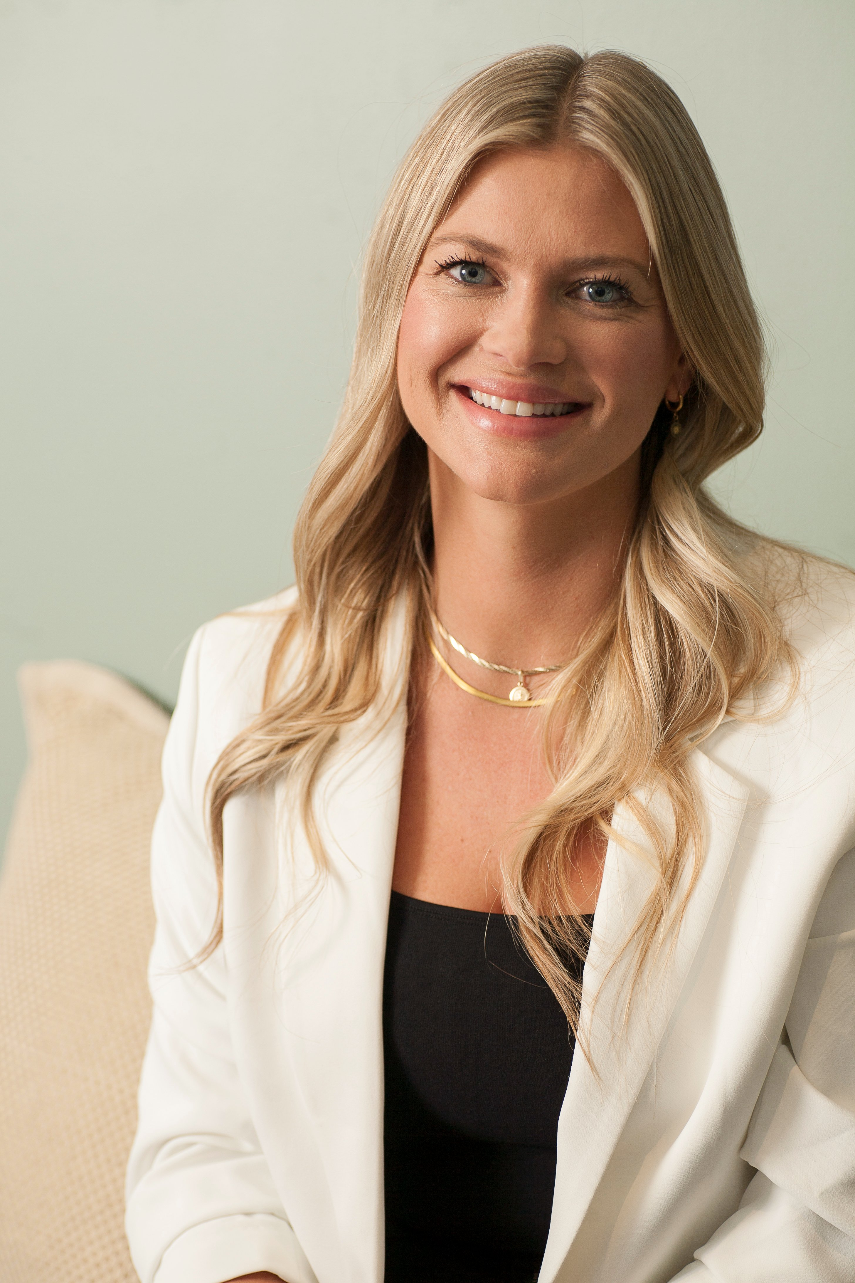
Who
We
Are
Kate Shelest
RN BSN MAIH
CAIEHP
CCHNC-C
Kim Derkach
RN BScN
HNB-BC HWNC-BC
CCHNC-C
GAHN Scholar
27yrs allopathic / 11 yrs holistic
Educator Langara College AIEHP
Student Advisor TheCIINDE©
Independent Nursing Practice – Synapse Integral Health Inc
Founder: The Conscious Nurse Project©
CHNA President / Board Member 2013 - present
Co-Founder The Canadian Institute of Integrative Nursing Development & Education Ltd. (TheCIINDE©),
Co-Creator & Lead Instructor of the CHNNC & C Certificate Program with TheCIINDE©
Faculty & Instructor at the U of SK
Nurse Entrepreneur
Educational Consultant for CHNA
Global Academy of Holistic Nursing (GAHN) Scholar
KShelest/KDerkach 2024

Slide 3

the power of communication: the words we use matter …
KShelest/KDerkach 2024

Slide 4
Definitions …
Holistic
This perspective is operationalized by an intentional, goal-based engagement in activities that support the physical, emotional, mental, and spiritual aspects of an individual’s experience of health …
The relationship between all elements of their lived experience, and the balance or imbalance between them are significant influencers of this process.
Integral
The process of integrating all aspects of Self which is inclusive and transcendent
Also reflects the practice of inclusivity of approaches, working together for a common goal
KShelest/KDerkach 2024

Slide 5
Holistic nurse
“A nurse who recognizes and integrates body-mind-emotion-spirit-environmental principles and modalities into daily life and clinical practice, creates a caring, healing space within herself or himself that allow the nurse to be an instrument of healing, shares authenticity of unconditional presence that helps to remove the barriers to the healing process, facilitates another's person's growth (body-mind-emotion-spirit-environment-energetic-connections), and assists with the recover from illness or transition to a peaceful death”
(Dossey, B. M., & Keegan, 2022, p.26)
KShelest/KDerkach 2024

Slide 6
Curing vs Healing
Curing
The process of alleviating or removing disease or symptoms from the body. It typically involves medical interventions such as medication, surgery, or other procedures that address physical conditions at a physiological level. Curing aims for a measurable outcome—the elimination of illness or symptoms.
Healing
A broader, multidimensional process that encompasses the physical, emotional, mental, and spiritual aspects of an individual. Healing focuses on restoring balance, harmony, and wholeness within a person, even when a cure isn’t possible. It’s often a journey towards peace, acceptance, and improved quality of life
(Dossey, B. M., & Keegan, 2022, p.101)
KShelest/KDerkach 2024

Slide 7
Holistic Nursing Process
“ An iterative and integrative process that involves six steps that can occur simultaneously
1) assessing
2) diagnosing or identifying patterns, challenges, and health issues
3) identifying outcomes,
4) planning care,
5) implementing the care plan, and
6) evaluating. "
(Dossey, B. M., & Keegan, 2022, p.26)
Does this look familiar?
KShelest/KDerkach 2024

Slide 8
Holistic ax : the experience of stress
a.k.a.
The BIG Picture
PHYSICAL
  Somatic symptoms
  Pain
  Fatigue
  Disease process
  Un-grounded
EMOTIONAL
  Shame/self-loathing
  Fear
  Anxiety/depression
  Agitation
  Panic
MENTAL
  Scattered thoughts
  Lack of insight
  Negative thought patterns
  Loss of objectivity
  Poor memory
SPIRITUAL
  Loss of faith
  Loss of sense of belonging
  Grief
  Moral distress
  Lost sense of self
plus the importance of familial, social, educational, environmental, transpersonal … aspects of Self
KShelest/KDerkach 2024

Slide 9
A comparative …
Aspect | Curing | Healing
Focus | Targets the disease or symptoms directly | Aims for overall balance and inner peace
Goal | Eradicate or reduce the illness | Restore a sense of wholeness and harmony
Process | Typically, fast and immediate, often through medical interventions | Can be gradual, involving lifestyle and mindset shifts
Measurement | Observable, medically validated results (e.g., test outcomes) | Personal experience, subjective improvement, quality of life
Approach | Physical/biological | Holistic: includes physical, emotional, mental, and spiritual
an integrative approach combines aspects of both … thoughts?
(Dossey, B. M., & Keegan, 2022, p. 101)

Slide 10
Why is this an important topic?
Subjectively
Our allopathic work experience
Our holistic work experience
Objectively
Research regarding holistic nursing practice and client outcomes
The ‘system is failing’ … what is missing?
What’s your experience?
Holistic Nursing knowledge is a powerful force & change agent in Health Care.
How might Holistic modalities be integrated into current Nursing practice, supported by Nursing knowledge?
KShelest/KDerkach 2024

Slide 11
Relevance of Holism
Regulated nurse professionals are bound by their Standards of Practice and Code of Ethics to support their own health and maintain fitness to practice.
The CNA Code of Ethics endorses the WHO’s definition of health as:
“… a state of complete physical, mental (spiritual), and social well-being, not merely the absence of disease”
(CNA, 2017, p. 23)
This is
acknowledgment of the interactive relationship
between all dimensions of the human experience as holistic
⸫ holistic perspectives in nursing practice & self-care are valid resources to support the health of clients and nurses.
KShelest/KDerkach 2024

Slide 12
Theory and Research
Barbara Dossey
Core Ideas: Dossey’s model, known as Theory of Integral Nursing, is based on Ken Wilber’s Integral
Theory and incorporates four quadrants: subjective, objective, intersubjective, and inter-objective.
It provides a comprehensive framework for looking at all aspects of the patient and healthcare
environment.
Key Contribution: Integral Nursing Theory, which combines holistic nursing principles with Wilber’s
integral theory, promotes an inclusive approach that encompasses physical, emotional, social, and spiritual aspects.
Helen Erickson, Evelyn Tomlin, and Mary Ann Swain
Core Ideas: Their Modeling and Role-Modeling Theory (MRM) considers each person unique, with individual experiences, needs, and values. The nurse’s role is to model respect and care, and to role-model self-care behaviors.
Key Contribution: MRM is highly holistic in nature, advocating that nurses see each patient as a whole, complex individual. It underscores the importance of empathy and helping patients reach their potential.
Rosemarie Rizzo Parse
Core Ideas: Parse developed the Human Becoming Theory, which suggests that humans co-create health based on personal choices and values. It focuses on understanding each person’s lived experience and is centered on three main principles: meaning, rhythmicity, and transcendence.
Key Contribution: Emphasizes the individuality of each patient’s experience and their role in co-creating health, aligning with holistic nursing’s respect for autonomy and personal choice.
(Dossey, B. M., & Keegan, 2022, p. 152)
Barbara Dossey T.I.N (2008, p. E67)
KShelest/KDerkach 2024

Slide 13
Florence Nightingale
Core Ideas: Nightingale is widely regarded as the founder of modern nursing and emphasized that healing environments are crucial for health and recovery.
She advocated for clean air, light, nutrition, and warmth to support the body’s natural healing process, a core holistic principle.
Key Contribution: Environmental Theory, which promotes the idea that the environment plays a significant role
in healing, laying the foundation for holistic nursing.
Jean Watson
Core Ideas: Watson’s Theory of Human Caring focuses on caring as a moral and ethical ideal. She views nursing as a humanistic science with an emphasis on the
transpersonal relationships between nurse and patient.
Key Contribution: Caring Science Theory, which describes the importance of caring and compassion, emphasizing mental, emotional, and spiritual
care alongside physical health.
Martha Rogers
Core Ideas: Rogers developed the Science of Unitary Human Beings, where people are seen as energy fields in constant interaction with the universe.
This model encourages viewing patients as whole beings and emphasizes the interconnectedness of physical, psychological, and environmental health.
Key Contribution: Emphasizes the holistic nature of nursing by focusing on energy fields and the human-environment connection, promoting a vision of nursing
that sees patients as dynamic, whole systems.
Margaret Newman
Core Ideas: Newman’s Theory of Health as Expanding Consciousness suggests that health is not merely the absence of disease but an evolving process of personal growth
and awareness. Illness is viewed as an opportunity for self-awareness and transformation.
Key Contribution: This theory shifts the focus from curing illness to facilitating patients’ inner journeys toward expanded consciousness and self-understanding.
(Dossey, B. M., & Keegan, 2022, p. 152)
CHNA http://www.chna.ca/about-us/
AHNA https://www.ahna.org/Resources
KShelest/KDerkach 2024

Slide 14

What would it take to bridge the gap between …
Modern/Allopathic Nursing Practice
which doesn’t necessarily recognize the integration of complimentary practices such as body/mind/spirit therapies and transpersonal approaches to patient care.
Holistic/Integrative Nursing Practice
which recognizes and accepts complimentary practices such as body/ mind/spirit therapies and transpersonal approaches to patient care.
KShelest/KDerkach 2024

Slide 15


Education & Awareness
CHNA MISSION Statement
To support the practice of holistic nursing across Canada by acting as a body of knowledge for its practitioners, by advocating with policy makers and provincial regulatory bodies and by educating Canadians on the benefits of complementary and integrative health care.
CHNA VISION Statement
Complementary and integrative health care are incorporated into all aspects of nursing and the patient care experience within the Canadian health care system
An ongoing CHNA goal is to reach out to
nursing schools, students, and practicing nurses
to educate and support them in
holistic theory and practice integration.
www.chna.ca
KShelest/KDerkach 2024

Slide 16
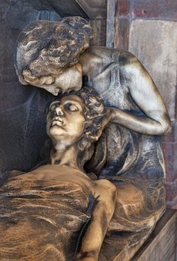
It’s your path …
‘How do I become a holistic nurse?’ …
is one of the most common questions we get at the CHNA.
Answer …
You can absolutely obtain a certification in holistic nursing
and
You don’t need a certification to be a holistically informed nurse and view your practice through a holistic lens.
KShelest/KDerkach 2024

Slide 17

Education cont. …
Formal vs Informal
Certifications
Nursing vs non-nursing
Postgraduate
Self learning
Mentors
Inner wisdom
Personal experiences / growth
KShelest/KDerkach 2024

Slide 18

Why is ‘Holistic’ Theory in Nursing Important?
  supports nursing practice grounded in a body-mind-spirit focus
  acknowledges the interplay of all aspects of self, in context to community, environment, and transpersonal needs
  may be presented in an ‘analytical’, organized, inclusive framework (e.g. Dossey’s T.I.N.)
  provides more tools to better serve our clients when we consider them physically, emotionally, mentally, and spiritually
  provides a foundation for self-care for clients and nurses
  Healing the Whole Person
  (not just ‘the hip’ in Rm 251)
KShelest/KDerkach 2024

Slide 19
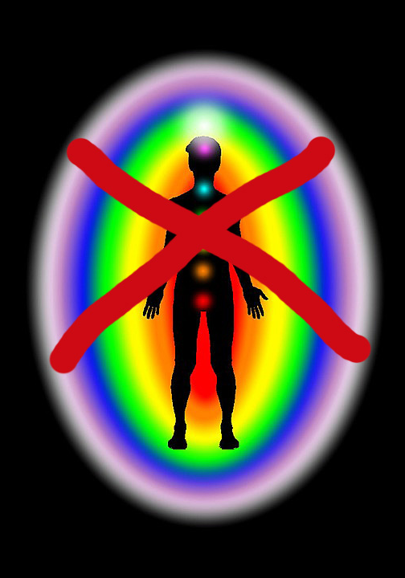
Reality check … barriers to practice
Experiential: CAM not well utilized or often experienced
Educational: formal vs informal
Collegial: peer support (or not)
Personal & Public: belief systems / world views
Funding: coverage for nurses in independent practice
Institutional/Practice Venue:
  e.g. no time to complete basic tasks of contemporary nursing
  employer support (allopathic vs integral)
  typically refer out to other teams (silo -scope)
Research Based Practice?
  “To date, there have been no reports of the actual practice situations
  where these modalities [*TT & HT] are selected for use”.
(Frisch, Butcher, Campbell & Weir Hughes, 2018, p. 210)
              *TT – Therapeutic Touch HT- Healing Touch
What has your experience been?
KShelest/KDerkach 2024

Slide 20
Holistic self-care … why is this important?
a quick note
Stress & Burn Out
Exposure to stressors occurs in acute and non-acute practice
Provincial studies of acute care, community care, & long-term care: nurses reported “worsening mental health … and lower quality of nursing care” (Havaei et al., 2020a, p. 14)
Impact of mechanistic approaches to practice: nurses suffer from emotional and moral distress,” leading to outcomes that include “… emotional exhaustion/burnout, job dissatisfaction and eventual exit from the profession” (Macphee et al., 2017, p. 3)
Stress from various sources: linked with “changes in cognitive, behavioural, and emotional function that can compromise professional caring” (Dyess et al., 2018, p. 79)
Regulated nurse professionals are bound by their Standards of Practice and Code of Ethics
to support their own health and maintain fitness to practice … physically, emotionally, mentally, & spiritually …
Holistically
KShelest/KDerkach 2024

Slide 21
Holistic Nursing and the Future of Healthcare
  Alignment with Healthcare Trends: Holistic nursing aligns with the shift towards
  preventive care, patient-centered care, and integrative medicine.
  Response to the Nursing Shortage: Holistic nursing practices can improve nurse retention
  by reducing burnout and culture shifts in nursing (Nursing Retention Toolkit).
  Introduction of Theory: at the educational level of nursing students, and offer holistic
  Self-care support at the workplace, and to already burnt-out nurses to aid recovery.
What else … ?
KShelest/KDerkach 2024

Slide 22

Where to now?
Provide resources/get familiar ..
^access to holistic modalities via experiential, self-care practices
^access to Theory & Research
^integration of holistic theory into nursing education
^integrate ‘Holistic’ into what nurses already do
^supports to working & burnt-out nurses
^educational opportunities
^start talking
because things are evolving …
What else ….?
KShelest/KDerkach 2024

Slide 23
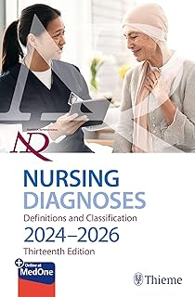
NANDA
Definitions & Classifications (2023-26) Edition 13
Nanda International Nursing Diagnosis recognizes elements of holistic nursing as
valid nursing diagnoses:
Domain 1 – Class 1 – Diagnosis Code 00273 Imbalanced Energy Field
Definition: disruption in the human electromagnetic field that is normally a continuous whole and is unique, dynamic, creative and nonlinear (p. 212)
Domain 10 – Class 3 – Diagnosis Code 00175 Moral Distress
Definition: response to the inability to carry out one’s chosen ethical or moral decision and/or action (p. 212)
Domain 10 – Class 3 – Diagnosis Code 00454 Impaired Spiritual Well-being
Definition: diminished integration of meaning and purpose in life though connections with Self, others, the World, and/or a power greater than oneself (p. 213)
Also see : Risk for Impaired Spiritual Well-being & Readiness for Enhanced Spiritual Well-being …
KShelest/KDerkach 2024

Slide 24
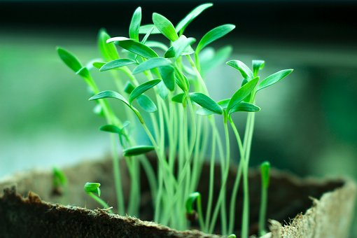
We have a foundation
Nurses are essentially trained to view the client physically, emotionally, mentally, and spiritually
Healing Touch, Therapeutic Touch and Reiki is already notably practiced (recognized by staff & clients)
e.g. in Hospice/Palliative care settings
Holistic Nurse Coaching is also a recognized as within our scope of practice, as a tool we integrate into
the nursing process
The public is looking for alternative and complimentary health care approaches ….
a grass roots paradigm shift
KShelest/KDerkach 2024

Slide 25
OPEN DISCUSSION
KShelest/KDerkach 2024

Slide 26
References and Further Reading
American Holistic Nurses Association, & American Nurses Association. (2013). Holistic nursing: Scope and standards of practice (2nd ed.). Nursesbooks.org.
ANA, & AHNA (2019). Holistic nursing standards of practice. ANA Enterprise
British Columbia College of Nurses and Midwives. (2012). Professional Standards for Registered Nurses and Midwives. BCCNM.
https://www.bccnp.ca/Standards/RN_NP/StandardResources/RN_NP_ProfessionalStandards.pdf
Canadian Holistic Nurses Association. (2022). Holistic nursing standards of practice. https://www.chna.ca/chna-standards-of-practice/
Canadian Nurses Association. (2017). Code of ethics for registered nurses. Canadian Nurses Association.
https://cna-aiic.ca/html/en/Code-of-Ethics-2017-Edition/files/assets/basic-html/page-1.html#
Dossey, B. (2008). Theory of integral nursing. Advances in Nursing Science 31(1), E52-E73.
Dossey, B. M., & Keegan, L. (Eds.). (2022). Holistic nursing: A handbook for practice (8th ed.). Jones & Bartlett Learning
Dunn, P.A. (2019). Holistic healing. Theories, practices and social change. Canadian Scholars.
Dyess, S., Prestia, A., Marquit, D., & Newman, D. (2018). Self-care for nurse leaders in acute care environment reduces perceived stress: A mixed methods pilot study merits
further investigation. Journal of Holistic Nursing, 36(1), 79-91. https://doi.org/10.1177/0898010116685655
Frisch, N., Howard, K., Campbell, D. & Weir-Hughes, D. (2018). Holistic nurses’ use of energy-based caring modalities. Journal of Holistic Nursing 36(3), 210-217.
Havaei, F., MacPhee, M., Ma, A., Gear, A., & Sorensen, C. (2020a). A provincial study of nurses’ COVID-19 experiences and psychological health and safety in British Columbia, Canada:
Final report. 1-131. http://dx.doi.org/10.14288/1.0394563
Jain, S. (2022). Healing ourselves. Biofield science and the future of health. Sounds True.
Judith, A. (2004). Eastern body western mind (Revised). New York: Celestial Arts..
MacPhee, M., Dahinten, S., & Havaei, F. (2017). The impact of heavy perceived nurse workloads on patient and nurse outcomes. Administrative Sciences, 7(7),
1-17. https://doi.org/10.3390/admsci7010007
World Health Organization. (2020). Year of the nurse and midwife 2020. https://www.who.int/campaigns/year-of-the-nurse-and-the-midwife-2020
Wilbur, K. (2007). The integral vision. Shambala.
KShelest/KDerkach 2024

