Slide 1
Holistic Nurse Coaching
A Case Study presented by
Kate Shelest RN BSN MAIH
CCHNC-C
©Kate Shelest 2024

Slide 2
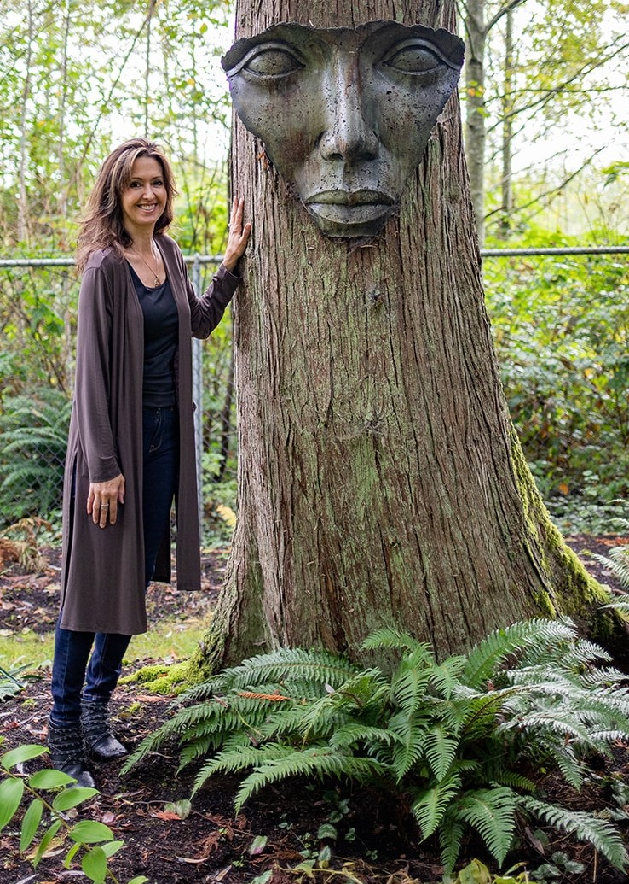
RN in BC, BSN (UVIC) MA in Integral Health (CIHS)
CIINDE Certified Holistic Nurse Coach/Consultant
TheCIINDE© Student Advisor
Independent nursing practice: Synapse Integral Health Inc.
The Conscious Nurse Project©
Beyond Bones
Nurse First
All care is informed by the Nursing Process, Standards of Practice and Code of Ethics
Tools
Holistic Nurse Coaching
Advanced Integrative Energy Healing©
Inclusive holistic approach that acknowledges all aspects of Self.
©Kate Shelest 2024

Slide 3

Clients
Word of mouth (clients & practitioners)
GP ref / adults only
Most not fully aware of ‘holistic’ perspectives
Some have ‘holistic’ practices that support them p/e/m/s
Presentations
Grief (acute/complex)
Stress management (multi-source)
Burnout (work)
Energetic imbalance (NANDA 2024)
©Kate Shelest 2024

Slide 4
Case Study: Debbie
56 yrs old
Full-time Manager - community services
Wife & Mom of 2 older teenagers
Large family of origin – 8 sibs (4 transitioned)
Recent loss of parent
New to ‘holistic’ perspectives
Word of mouth referral
Holistic Nurse Coaching Experience
Initial 2hr session with 4 x1hr sessions
over 2 months
1:1 in person on site @ holistic clinic
Note:
consent was obtained to present this
case study example
©Kate Shelest 2024

Slide 5
Session 1
Goals/Intentions I.D.’d
Decrease anxiety in stressful situations
Strategies Used
Story Theory
Compassionate inquiry
Tools Offered
NS regulation: foot paddling / breath work
Basic grounding exercise
Holistic Self-Assessment
Co-created Plan
To use tools daily and as needed.
Journal thoughts/emotions that might come up between sessions
Coaching container created
Guided grounding meditation offered
Holistic Assessment
Client
needed to ^talk re: grief & work stress
anxiety and stress response
tearfulness
scattered thoughts
“I am scattered, and I am not in my body”
Client Choice: N/S Self-regulation / breathwork
©Kate Shelest 2024

Slide 6

Assessment Tools
IHWA Long Form
integrative health and wellness assessment
(McElligott et al, 2028)
33 item assessment form : 1-5 scale
Physical/emotional/mental/spiritual/relational/environmental
Correlates to show areas of strength and areas of challenge
Holistic Assessment Short Form (Shelest, 2015)
Demographics/primary contacts
Healthcare team/health history/medications
Pain/Stress scales 1-10
Self-care practices
P/E/M/S - used for updates throughout sessions
The holistic assessment process often creates space for deep reflection in the moment and
during the time between appointments.
©Kate Shelest 2024

Slide 7
Self Assessment
Holistic Self-assessment Tool
Used daily with mindfulness meditation to connect with Self holistically. Balance/imbalance between consciousness is identified; internal and external resources will be identified and used to support balance via individualized holistic self- care practices.
spiritual
mental
emotional
physical
 | Sun | Mon | Tues | Wed | Thurs | Fri | Sat
Physical
Emotional
Mental
Spiritual
 | Sun | Mon | Tues | Wed | Thurs | Fri | Sat
Physical
Emotional
Mental
Spiritual
 | Sun | Mon | Tues | Wed | Thurs | Fri | Sat
Physical
Emotional
Mental
Spiritual
 | Sun | Mon | Tues | Wed | Thurs | Fri | Sat
Physical
Emotional
Mental
Spiritual
SELF
Inspired by Sri Aurobindo’s
Theory of Consciousness &
Integral Yoga
Initially too complicated for client to absorb … chose to start after Session 2
Concentric Map of Consciousness adapted with permission from Lamb, R.M. (2012). Human becoming. A guide to soul-centered living. Cittam Futures Inc.
©2021 Synapse Integral Health Inc

Slide 8
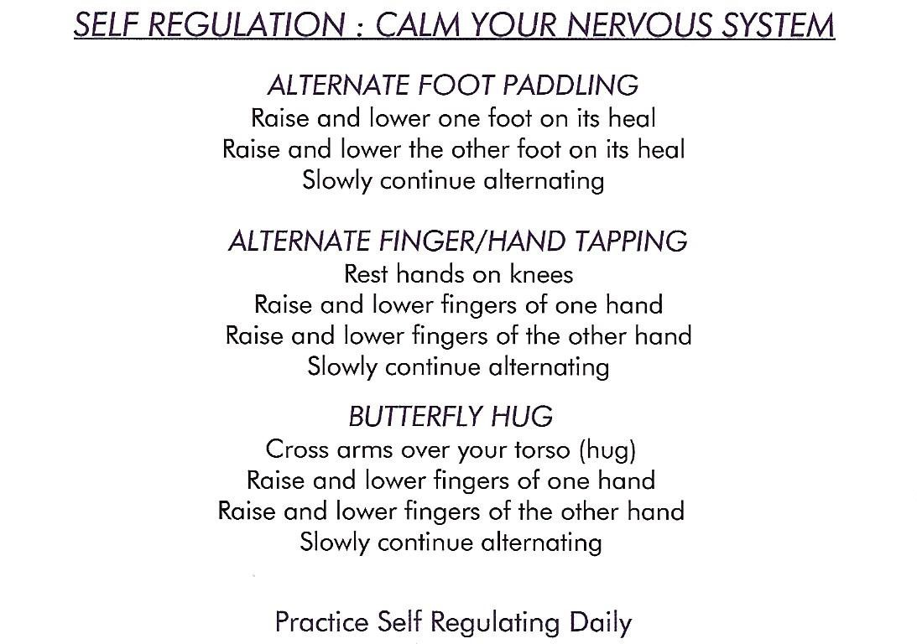
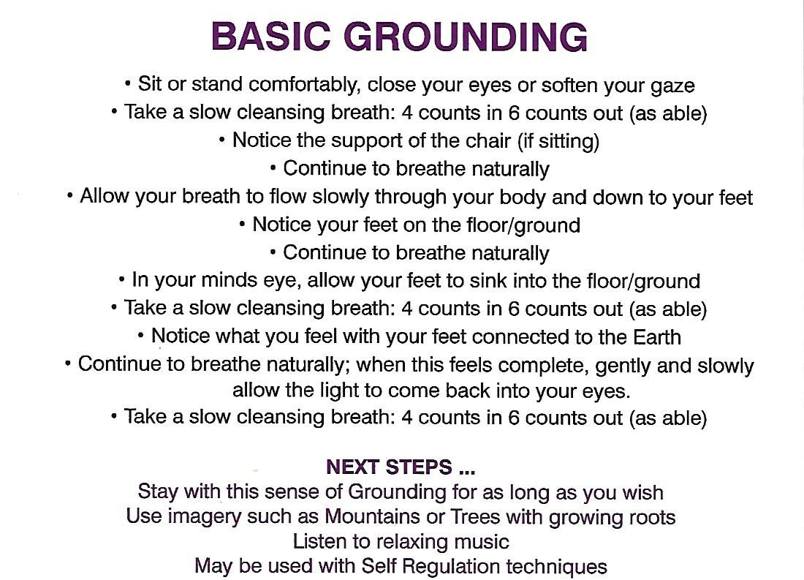
Tools Offered for Nervous System Regulation
and Grounding
Breathwork: extended exhale
©Kate Shelest 2024

Slide 9
Session 2
Goals/Intentions I.D.’d
To release guilt of moving forward at work
Strategies Used
Reflective/Motivational Interview
Compassionate inquiry
Core Values Assessment
Tools Offered
Mantra - Positive Affirmation
NS regulation: foot paddling / breath work (will continue)
Holistic Self-Assessment (will continue)
Co-created Plan
To use tools daily and as needed
Journal thoughts/emotions that might come up between sessions
Coaching container created
Guided grounding meditation offered
Review of past 2 weeks
Client:
sense of being blocked at the knees
needed to talk re: work stressors
^guilt with job promotion
self-ax = mental / thought processes
“People tell me I’m good at what I do; I want the promotion, but I block my progress going forward
d/t fear of leaving people behind”
Client Choice: Mantra - “I will go forward with courage”
©Kate Shelest 2024

Slide 10
Session 3
Goals evolve as inner wisdom awakens … & the client does the work
Goals/Intentions I.D.’d
To learn to let go …
Strategies Used
Compassionate inquiry
Core Values Assessment
Tools Offered
Mantra - Positive Affirmation (as needed)
NS regulation: foot paddling / breath work (will continue)
Grounding meditation (will continue)
Holistic Self-Assessment (will continue)
AIEH (to end sessions)
Co-created Plan
To use tools daily and as needed
To define ‘letting go’
Journal thoughts/emotions to tell her story
Coaching container created
Guided grounding meditation offered
Review of past 2 weeks
Client:
grief is less heavy with grounding
family conflict has now come up
^scattered and unfocussed
need to tell her story – decompressing
self-ax = mental / emotions dominant
“My husband tells me I need to let it go” What would it look like to let things go? “I’m not sure”
Client Choice: “to define ‘letting go’ … does it align with my Core Values?”
©Kate Shelest 2024

Slide 11
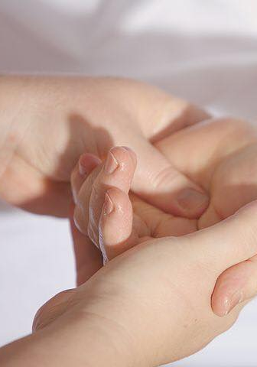
Tool: Integrative Energy Healing
Client aware of & requested assist with grounding through integrative energy work.
Includes:
hands on support (like TT)
awareness dialogue = somatic awareness
  how do I ground?
  how does it feel to ground?
  how do I know I’m grounded (p/e/m/s)
mindfulness – notice that I am grounded
breathwork – grounding embodiment
This was provided at the end of Sessions 3 – 5 to
support grounding and balance physically, emotionally, mentally, and spiritually

Slide 12
Session 4 – The SHIFT
Goals/Intentions I.D.’d
To strengthen my ability to ground in stressful situations
Strategies Used
Compassionate inquiry
Review of Core Values Assessment
Review of Inner and Outer Resources
Tools Offered
Mantra - Positive Affirmation (as needed)
NS regulation: foot paddling / breath work (will continue)
Grounding meditation (will continue)
Holistic Self-Assessment (will continue)
AIEH (to end sessions)
Co-created Plan
To use tools daily and as needed
To consider Resources and formulate a plan to achieve goal
Coaching container created
Guided grounding meditation offered
Review of past week
Client:
core values work connected her to her inner wisdom
Spirit emerges … connection to Jesus & sense of peace
Ah ha moment:
“All my stress – I just need to ground”
“I feel lighter, the sadness/stress is still there but not taking me over”
Client Choice: “to create a plan to strengthen my grounding to cope with stressful situations.

Slide 13
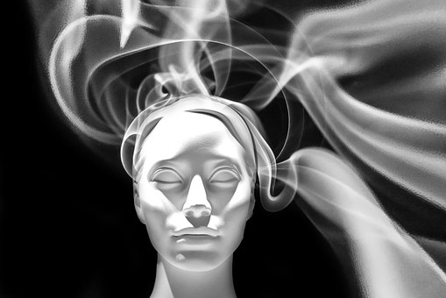
Identified Themes Review
4 Themes were identified through this assessment:
Grief due to loss of parent in the past year
Mental stress due to perception of self at work
Emotional stress due to family relationships
The sense of feeling ‘disconnected from my body’ and the need for ‘getting solid again’
©Kate Shelest 2024

Slide 14

Intention / Goals
Debbie’s perceived stress from various sources was impacting her physically, emotionally, mentally & spiritually.
The sense of feeling ‘disconnected from my body’ and the need for ‘getting solid again’ was present with all 4 themes.
Therefore, she decided that her over-arching Goal for coaching was:
‘to improve my ability to be grounded in my body’
to better deal with stress
©Kate Shelest 2024

Slide 15

Planning: Inner & Outer Resources
+
Nervous System Regulation
Bilateral, oscillatory self-regulation (foot-paddling)
Guided Grounding Meditation
Breathwork- extended exhale
With self-reflection on past positive experiences, Debbie was able to identify inner and outer resources that had helped her thru previous difficult times:
Self- Discipline
Nature / Forest
Resilience
Physical Exercise
Work Ethic
Positive Feedback
Family Support
Problem Solving
Jesus
©Kate Shelest 2024

Slide 16
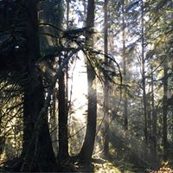
Co-created Plan
Based on her stated goal and the Nurse Coaching process, Debbie was supported to explore her values, her resources and tools to consider in her self-care planning.
Through this self-assessment, and deep personal work, Debbie believed these activities will support grounding, connect her to nature and her spirituality, strengthen her n/s self- regulation, & help her cope better with stressful situations.
Walk in Nature with her dog 3 days/wk. x 45 mins
Use N/S self-regulation exercises daily as needed
Listen to Guided Grounding meditation at bedtime daily
Use Holistic Self-assessment to track p/e/m/s balance
Review: at the end of each week.
Adjust: as needed (adjust time frames/add resources)
Debbie felt this schedule was doable without adding more pressure. She gave herself permission to change the plan as needed, without judgement.
©Kate Shelest 2024

Slide 17

Session 5
Coaching container created
Guided grounding meditation offered
Review of past 3 weeks
Evaluation
All sessions: 1-5 stress scale was used to measure client’s reported stress levels.
4-5 in first 3 sessions.
2-3 in sessions 4 & 5
Plan was adjusted due to time frames and commitments that arose. Debbie consistently uses her N/S self-regulation practices.
Client Transformation Over Time:
I feel so solid; I can ‘feel’ grounded
I feel content and can sense Joy
I am using my resources when I get triggered
paddling / extended breath
resting more
doing morning meditation to connect to heart space and Jesus.
I can hold onto and sense gratitude more often
I am surrendering what I can’t control better
I am embracing my Self
Somatic awareness became a measuring stick for stress levels and progress in dealing with challenging situations …

Slide 18

This Nurse Coaching Experience:
Our clients know
Everyone has a different way of releasing stress
Goals may not be concrete from session to session
Deep listening and holding space allows themes to arise
Connecting a client to their inner wisdom can come from deep listening and compassionate inquiry
Clients might need ‘permission’ to be the decision maker
Offering holistically based tools to support the p/e/m/s aspects of health provides a well round, integral palette for our clients to choose from

Slide 19

thank you

Slide 20
References
IHWA long Form- integrative health and wellness assessment
(McElligott et al, 2028)
www.synapseintegralhealth.com
www.theconsciousnurseproject.ca
nursing@shaw.ca
synapsehealth@shaw.ca
NANDA International (2024). Nursing diagnosis. Definitions and classification 2024 – 2026 (13th Edition). Thieme. Editors: T. Heather Herdman/ Shigemi Kamitsuru. Camila Takao Lopes

