Slide 1
Taking holistic to work
© 2025 Kim Derkach & Kate Shelest

Slide 2

agenda
About us
Holistic Nursing Theory
Holistic in the workplace
Benefits / barriers
© 2025 Kim Derkach & Kate Shelest

Slide 3

About us
Intentional Integration of Holistic Nursing Practice
© 2025 Kim Derkach & Kate Shelest

Slide 4
Kim Derkach
RN BScN
HNB-BC HWNC-BC
CCHNC-C
GAHN Scholar
Kate Shelest
RN BSN MA-Integral Health
Canadian Holistic Nurses Association
CCHNC-C
CAIEHP
Holistic Nurse : Body Mind Spirit
“A nurse who recognizes and integrates body-mind-emotion-spirit-environmental principles and modalities into daily life and clinical practice, creates a caring, healing space within herself or himself that allow the nurse to be an instrument of healing, shares authenticity of unconditional presence that helps to remove the barriers to the healing process, facilitates another's person's growth (body-mind-emotion-spirit-environment-energetic-connections), and assists with the recover from illness or transition to a peaceful death”
(Dossey, B. M., & Keegan, 2022, p.26)
What is your definition?
© 2025 Kim Derkach & Kate Shelest

Slide 5
HOLISTIC NURSING – Theory
Barbara Dossey: Theory of Integral Nursing, is based on Ken Wilber’s Integral Theory and incorporates four quadrants: subjective, objective, intersubjective, and inter-objective.
Helen Erickson, Evelyn Tomlin, and Mary Ann Swain: Modeling and Role-Modeling Theory (MRM) considers each person unique, with individual experiences, needs, and values. MRM is highly holistic in nature, each patient as a whole, complex individual.
Margaret Newman: Theory of Health as Expanding Consciousness suggests that health is not merely the absence of disease but an evolving process of personal growth and awareness. Illness is an opportunity for self-awareness and transformation.
Jean Watson: Theory of Human Caring focuses on caring as a moral and ethical ideal. She views nursing as a humanistic science with an emphasis on the transpersonal relationships between nurse and patient.
Martha Rogers: Science of Unitary Human Beings, people are seen as energy fields in constant interaction with the universe; it emphasizes the interconnectedness of physical, psychological, and environmental health. (Dossey, B. M., & Keegan, 2022, p. 152)
CHNA http://www.chna.ca/about-us/
AHNA https://www.ahna.org/Resources
Discover more >
© 2025 Kim Derkach & Kate Shelest

Slide 6
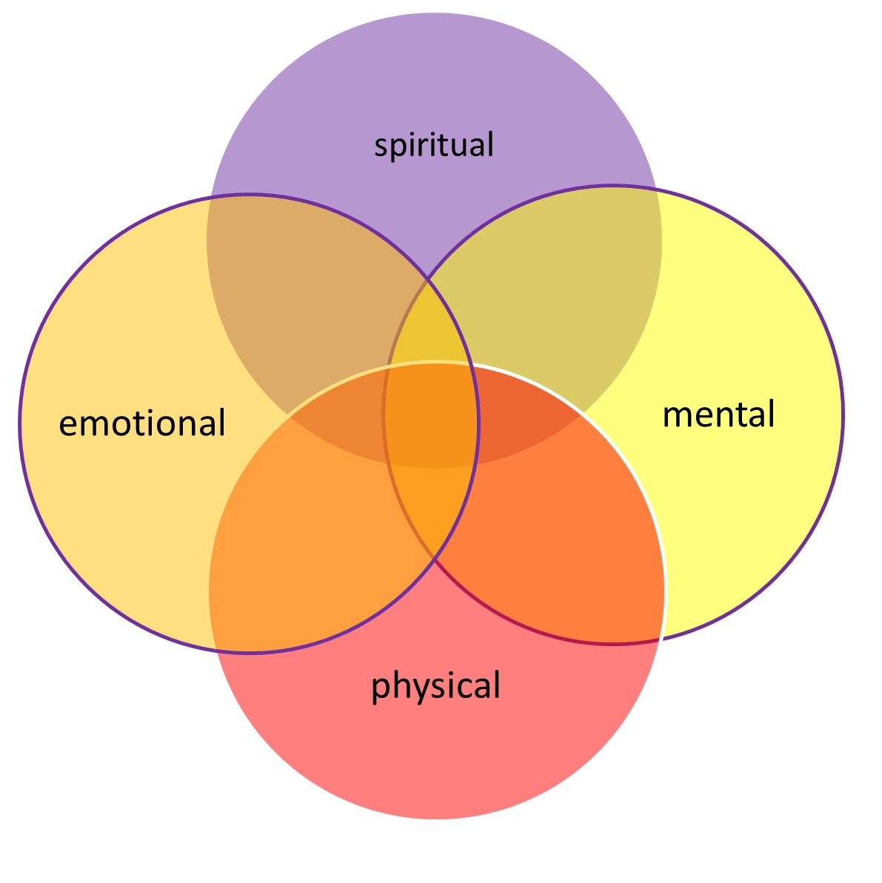
Integration of Holistic Nurse Theory & Practice into our current workspaces
Why would we?
& how could we?
Your thoughts … ?
© 2025 Kim Derkach & Kate Shelest

Slide 7

Formal vs informal
© 2025 Kim Derkach & Kate Shelest

Slide 8
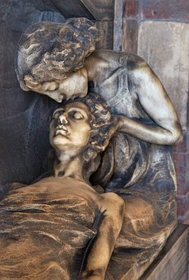
You can absolutely obtain a certification in holistic nursing
and
You don’t need a certification to be a holistically informed nurse and view your practice through a holistic lens.
© 2025 Kim Derkach & Kate Shelest

Slide 9
Be creative
OTHER SUGGESTIONS?
Learn it – Embody it – Bring it
Self-care
Inner wisdom
Mentors
View through Holistic Lens-
Physical Emotional Mental & Spiritual
Learn it – Embody it – Bring it – DO It
NANDA care planning
Formal Holistic Assessments & Documentation
CIMs
Formal Certifications
Role Modelling
*Remember*
NURSE FIRST
© 2025 Kim Derkach & Kate Shelest

Slide 10
NANDA Nursing Diagnoses
Why are these holistic?
Domain 1 – Class 1 – Dx Code 00273 (p. 212)
‘Imbalanced energy field’
‘Definition: Disruption in the human electromagnetic field that is normally a continuous whole and is unique, dynamic, creative and nonlinear.’ (p.212)
Domain 10 – Class 3 – Dx Code 00175 (p. 524)
‘Moral distress’
‘Definition: Response to the inability to carry our one’s chosen ethical or moral decision and/or action’ (p. 524)
Domain 10 – Class 3 – Dx Code 00454 (p. 525) *see also Dx Codes 00460/00068
  ‘Impaired spiritual well-being’
  ‘Definition: Diminished integration of meaning and purpose in life through connections with self, others, the world, and/or a power greater than oneself’. (p. 525) (Herdman, T. H., Kamitsuru, S., & Takáo Lopes, C., 2024).
Do we consider these part of the ‘human’ experience?
© 2025 Kim Derkach & Kate Shelest

Slide 11

‘Holistic’ DX as part of co-created care plan
Ax
  Review defining characteristics, co-existing conditions, risk levels
Implementation
  Support
  Mentor
  Monitor
Plan
  Co-create with client
  Review resources
  Set goals
Evaluation
  Measuring outcomes based on goals
  Adjust plan as needed
physical emotional mental spiritual … & beyond
attainable / measurable / adjustable
realistic / required / requested
what has shifted PEMS?
© 2025 Kim Derkach & Kate Shelest

Slide 12
CIMs: to use or not to use (that is the question)
Energy Healing / Reiki
Crystals / Herbs
Functional Medicine
Meditation / Grounding / Breathwork
Client Requests / Cultural Supports
Remember
  Nurse First
Regulatory Body
  Scope of Practice
Permission
  Relevance, safety, research based?
What else comes to mind?
© 2025 Kim Derkach & Kate Shelest

Slide 13

Benefits of bringing holistic to your workplace
  supports nursing practice grounded in a body-mind-spirit focus
  acknowledges the interplay of all aspects of self, in context to community, environment, and transpersonal needs
  may be presented in an ‘analytical’, organized, inclusive framework (e.g. Dossey’s T.I.N.)
  provides more tools to better serve our clients when we consider them physically, emotionally, mentally, and spiritually
  provides a foundation for self-care for clients and nurses
Other benefits????
© 2025 Kim Derkach & Kate Shelest

Slide 14
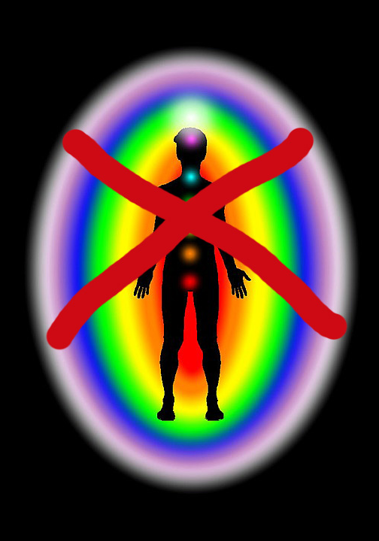
Barriers
Experiential: CIMs not well utilized or often experienced
Educational: formal vs informal
Collegial: peer support (or not )
Personal & Public: belief systems / world views
Funding: coverage for nurses in independent practice
Institutional/Practice Venue:
  e.g. no time to complete basic tasks of contemporary nursing
  employer support (allopathic vs holistic) *see next slide
  typically refer out to other teams (silo -scope)
Research Based Practice?
What has your experience been?
© 2025 Kim Derkach & Kate Shelest

Slide 15

Allopathic vs Holistic
Holistic nursing is integrative. It does not exclude allopathic approaches and fully acknowledges all aspects of Self.
Integrative:
The process of integrating all aspects of self which is inclusive and transcendent.
Also reflects the practice of inclusivity of approaches, working together for a common goal.
© 2025 Kim Derkach & Kate Shelest

Slide 16


What is your nursing practice
& how could you bring
‘Holistic to Work?’
nursing process
embody
workplace support
courage
role model
educate
© 2025 Kim Derkach & Kate Shelest

Slide 17
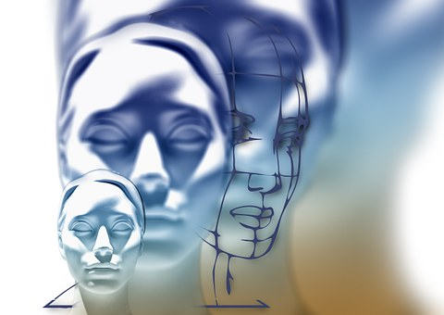
Vision for the future
Integrate holistic theory into curriculum
Integrate holistic theory into workplace policy development and staff support
????
© 2025 Kim Derkach & Kate Shelest

Slide 18
Resources and references & further reading
American Holistic Nurses Association, & American Nurses Association. (2013). Holistic nursing: Scope and standards of practice (2nd ed.). Nursesbooks.org.
ANA, & AHNA (2019). Holistic nursing standards of practice. ANA Enterprise
British Columbia College of Nurses and Midwives. (2012). Professional Standards for Registered Nurses and Midwives. BCCNM.
https://www.bccnp.ca/Standards/RN_NP/StandardResources/RN_NP_ProfessionalStandards.pdf
Canadian Holistic Nurses Association. (2022). Holistic nursing standards of practice. https://www.chna.ca/chna-standards-of-practice/
Canadian Nurses Association. (2017). Code of ethics for registered nurses. Canadian Nurses Association.
https://cna-aiic.ca/html/en/Code-of-Ethics-2017-Edition/files/assets/basic-html/page-1.html#
Dossey, B. (2008). Theory of integral nursing. Advances in Nursing Science 31(1), E52-E73.
Dossey, B. M., & Keegan, L. (Eds.). (2022). Holistic nursing: A handbook for practice (8th ed.). Jones & Bartlett Learning
Dunn, P.A. (2019). Holistic healing. Theories, practices and social change. Canadian Scholars.
Dyess, S., Prestia, A., Marquit, D., & Newman, D. (2018). Self-care for nurse leaders in acute care environment reduces perceived stress: A mixed methods pilot study merits
further investigation. Journal of Holistic Nursing, 36(1), 79-91. https://doi.org/10.1177/0898010116685655
Frisch, N., Howard, K., Campbell, D. & Weir-Hughes, D. (2018). Holistic nurses’ use of energy-based caring modalities. Journal of Holistic Nursing 36(3), 210-217.
Havaei, F., MacPhee, M., Ma, A., Gear, A., & Sorensen, C. (2020a). A provincial study of nurses’ COVID-19 experiences and psychological health and safety in British Columbia, Canada:
Final report. 1-131. http://dx.doi.org/10.14288/1.0394563
Herdman, T. H., Kamitsuru, S., & Takáo Lopes, C. (2024). Nursing diagnoses 2024 - 2026: Definitions and classification. Thieme Medical Publishers.
Judith, A. (2004). Eastern body western mind (Revised). New York: Celestial Arts..
MacPhee, M., Dahinten, S., & Havaei, F. (2017). The impact of heavy perceived nurse workloads on patient and nurse outcomes. Administrative Sciences, 7(7),
1-17. https://doi.org/10.3390/admsci7010007
World Health Organization. (2020). Year of the nurse and midwife 2020. https://www.who.int/campaigns/year-of-the-nurse-and-the-midwife-2020
Wilbur, K. (2007). The integral vision. Shambala.
© 2025 Kim Derkach & Kate Shelest

