Slide 1

The Conscious Nurse Project
an on-line holistic self-care workshop for nurses
© 2021 Synapse Integral Health Inc : Kate Shelest RN BSN MAIH

Slide 2
The conscious nurse project
The ‘Conscious Nurse Project’ began as a research proposal for my MAIH thesis.
The research proposal was developed specifically for the ‘Evaluation of an On-line Holistic Self-care Workshop for Registered Nurses’.
It wasn’t intended to exclude other nursing professionals; I was curious if there was anything specific to RNs in context to holistic self-care use and education.
The intervention aspect of the research proposal evolved into an on-line holistic self-care workshop.
The following touches on some of the important points discovered
through this process.
© 2021 Synapse Integral Health Inc

Slide 3
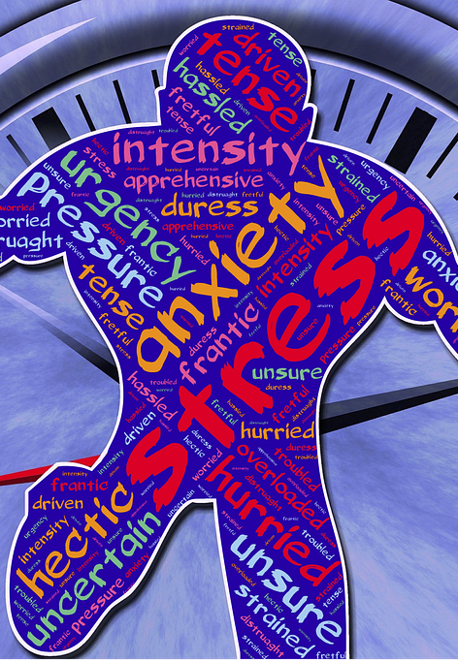
The issue
RNs Standards of Practice require them to maintain their health and fitness to practice.
RNs frequently experience challenging situations and workplace stressors
Trauma, and exposure to vicarious trauma
Impact is on physical, emotional, mental, and spiritual health
Can lead to reduced functioning and BURNOUT
COVID-19 has compounded the issue
This project explores holistic ways to support RNs capacity to maintain their health and fitness to practice.
G R I E F
© 2021 Synapse Integral Health Inc

Slide 4
scope & prevalence : STRess &burnout
Exposure to stressors occurs in acute and non-acute practice
Provincial studies of acute care, community care, & long-term care: RNs reported “worsening mental health … and lower quality of nursing care” (Havaei et al., 2020a, p. 14)
Impact of mechanistic approaches to practice: nurses suffer from emotional and moral distress,” leading to outcomes that include “… emotional exhaustion/burnout, job dissatisfaction and eventual exit from the profession” (MacPhee et al., 2017, p. 3)
Stress from various sources: linked with “changes in cognitive, behavioural, and emotional function that can compromise professional caring” (Dyess et al., 2018, p. 79)
© 2021 Synapse Integral Health Inc

Slide 5
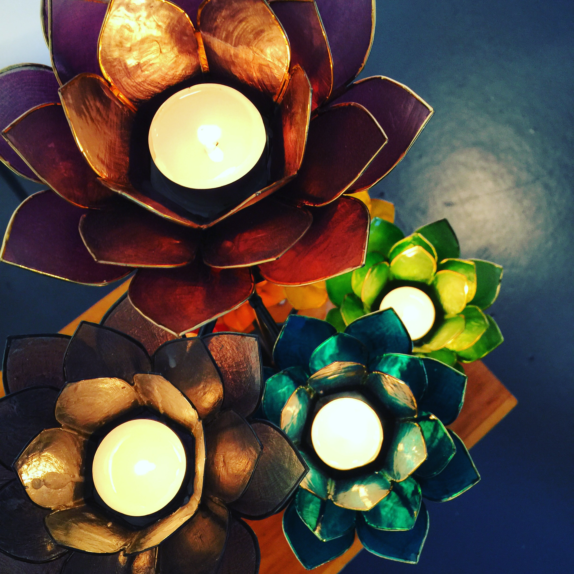
Nurses’ experience is physical emotional mental
& spiritual
RNs are bound by their Standards of Practice and Code of Ethics to support their own health and maintain fitness to practice.
The Code of Ethics endorses the WHO’s definition of health as:
“… a state of complete physical, mental (spiritual), and social well-being, not merely the absence of disease”
(CNA, 2017, p. 23)
This is
acknowledgment of the interactive relationship between all dimensions of the human experience is holistic
⸫ holistic self-care is a valid resource to support the health of RNs.
Nurses already know: intuition / ’vibes’ / the full moon effect /
toxic work environments / spiritual aspects of care / prayer …
© 2021 Synapse Integral Health Inc

Slide 6
Relevance of holism
Holistic approach to self-care as a means for supporting fitness to practice enhances ‘capacity for compassionate care of patients and their families’ (Mills et al., 2018, p. 12)
“While nursing research has identified common sources of moral distress, not every nurse will experience distress when faced with these situations” (Epstein and Delgado, 2010, para.11).
Nurses possess varying levels of resilience and may find satisfaction in providing care in challenging situations. Rushton et al. (2015) suggest creation and implementation of holistic self-care practices by RNs may strengthen and sustain that resilience from a whole person perspective, supporting health and fitness to practice.
While “provision of holistic care is a hallmark of competent nursing practice, holistic activities centered on self are less prevalent for nurses” (Blum, 2014, p. 2).
© 2021 Synapse Integral Health Inc

Slide 7
Holistic experience of stress
PHYSICAL
  ^Somatic Symptoms
  Pain
  Fatigue
  Disease Process
  Un-grounded
EMOTIONAL
  Shame/Self Loathing
  Fear
  Anxiety/Depression
  Agitation
  Panic
MENTAL
  Scattered thoughts
  Lack of Insight
  Negative Thought Patterns
  Loss of Objectivity
  Poor Memory
SPIRITUAL
  Loss of Faith
  Loss of Sense of Belonging
  Grief
  Moral distress
  Lost Sense of Self
© 2021 Synapse Integral Health Inc

Slide 8

Research Question how to create a workshop that will successfully engage RNs in effective and sustainable holistic self-care
Literature review topics:
methods for engaging RNs in holistic self-care,
methods of effective holistic self-care,
methods for teaching holistic self-care, and
methods for supporting sustainable holistic self-care.
*all in context to practicing nurses
© 2021 Synapse Integral Health Inc

Slide 9

Methods for engaging
What about …
Peer support
Perceptions
Science vs Woo Woo
Permission from Self
Worldview transformation, self-knowledge, and self-compassion: influential in the transformative process supporting engagement
Operational factors: time for training/practice; accessibility; work demands.
Organisational factors: employer support; financial compensation for participation in research; course accreditation. *
Research specific to the philosophical aspects of engagement in holistic self-care by nurses is lacking.
*The general impact of these influencers was not clear.
© 2021 Synapse Integral Health Inc

Slide 10
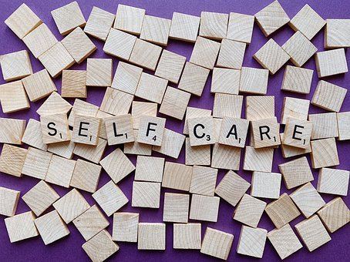
methods of effective holistic self-care
Where can I do this …
at home
at work
in the moment when I need it?
Yoga, breath-work for nervous system self-regulation, meditation, and mindfulness-based stress reduction practices were the most cited holistic self-care methods
Individualization of practices was recommended
Studies specific to whether theoretical knowledge of holistic self-care practices and concepts was important were not found.
A lack of follow-up data regarding the sustained use of these modalities by practicing RNs was noted.
© 2021 Synapse Integral Health Inc

Slide 11

Methods for teaching holistic self-care
What about …
experiential vs lecture
theory & research
science vs woo woo
mentors
the words we use matter
Interventional studies described on-site and on-line platforms (methods for teaching). There was a lack of literature for on-line platforms.
All on-line interventional studies were participant guided with some supportive email contact from instructors
Impact of instructor expertise in holistic theory/self-care was not specifically described. Data re: impact of instructor-facilitated versus self-directed learning in on-line platforms was lacking.
Common themes identified: accessibility to content; learning tools & resources; venue; and length of instruction/program time. Sensitivity to learning needs was noted in context to individualization of practices.
© 2021 Synapse Integral Health Inc

Slide 12

Methods for sustaining holistic self-care
What about …
permission from Self
connection to Self
embodiment of practice
individualized self care plans
based on self assessment
Sustaining holistic self-care is multi-dimensional. Completion of a training program does not ensure sustainability.
Individual regulatory requirements, evolving life circumstances, and individual capacity may influence enduring holistic self-care.
Limitations of this review: lack of data re: long-term follow-up in interventional studies, and impact of ongoing education/mentoring.
Reinforcement of practices in short increments over extended periods recommended, citing healthcare workers’ busy schedules as mediators of sustainability.
© 2021 Synapse Integral Health Inc

Slide 13
The conscious nurse project
developed as the intervention of my research proposal
created by integrating evidence from the literature review with foundational holistic and consciousness theories + feedback from clients and colleagues.
nurses taught holistic self-assessment, how to plan, implement, and evaluate their individualized holistic self-care plans
hopes to capture what RNs conceptualize as effective means for learning, engaging in, and sustaining their holistic self-care practices = a foundation for future program development.
© 2021 Synapse Integral Health Inc

Slide 14
Theoretical Framework
This workshop integrates:
Margaret Newman: theory of Health as Expanding Consciousness
Sri Aurobindo: Integral Yoga
Nervous System Self-regulation
  e.g. Stanley/van der Kolk/Ogden
Biofield Science: impact of subtle-energy
  e.g. Rubik/Brennan/Oschman/Jain
Consciousness + Energy
Systems impacting Systems
Physical/Emotional/Mental/Spiritual
© 2021 Synapse Integral Health Inc

Slide 15
Holistic Self-assessment Tool
Used daily with mindfulness meditation to connect with Self holistically. Balance/imbalance between consciousness is identified; internal and external resources used to support balance via individualized holistic self care practices.
spiritual
mental
emotional
physical
 | Sun | Mon | Tues | Wed | Thurs | Fri | Sat
Physical
Emotional
Mental
Spiritual
 | Sun | Mon | Tues | Wed | Thurs | Fri | Sat
Physical
Emotional
Mental
Spiritual
 | Sun | Mon | Tues | Wed | Thurs | Fri | Sat
Physical
Emotional
Mental
Spiritual
 | Sun | Mon | Tues | Wed | Thurs | Fri | Sat
Physical
Emotional
Mental
Spiritual
SELF
Inspired by Sri Aurobindo’s
Theory of Consciousness &
Integral Yoga
Concentric Map of Consciousness adapted with permission from Lamb, R.M. (2012). Human becoming. A guide to soul-centered living. Cittam Futures Inc.
©2021 Synapse Integral Health Inc

Slide 16
Workshop*
FORMAT
1 hour guided sessions; weekly x 5
Fully on-line; all resources available on website
Recorded for flexible access
Instructor: nursing and holistic practice background
Mentored during; with 2 sessions post workshop
Resources for deeper learning provided.
Experiential & Self-reflective
Holistic approaches to health acknowledge the existence and interactive relationship between all dimensions of the human experience.
The Conscious Nurse Project is designed to bring active awareness to all aspects of being, and provide practical ways to integrate self-care to support nurses’ health and practice.
*created through the integration of the literature review with basic holistic & consciousness theory.
© 2021 Synapse Integral Health Inc

Slide 17

Program Objectives
Learning Outcomes
The main objective of the Conscious Nurse Project is to support registered nurses in embodying holistic self-care by:
introducing basic holistic self-care concepts,
providing and teaching how to use a holistic self-assessment tool,
teaching basic holistic self-care practices,
facilitating development of holistic self-care plans that are individualized and effective.
By the end of the course, participants will be able to:
Demonstrate
a foundational knowledge of the concepts of holistic health and holistic self-care,
Utilize
a holistically based self-assessment tool
Identify
holistic aspects of Self (physical, emotional, mental, and spiritual) that require support
Identify
internal & external resources to support an individualized plan
Implement and embody
an individualized, holistic self-care plan supportive of their personal and work environments
Evaluate
effectiveness of their self-care plan, fine-tuning as necessary
© 2021 Synapse Integral Health Inc

Slide 18
Practices
make space
strengthen energetic boundaries
connect with spiritual energy
clear your head
re-connect with your Self
connect with Earth energy
raise your vibe
focus
calm your Self
release
build resilience
Participants will be taught the basics of:
*Grounding
*Breath
*Nervous System Self-regulation
Mindfulness
Meditation
This is an introductory workshop
Practices that can be used ‘in the moment’ & long term
Resources: internal and external
Individualized holistic practices and self-care plans are honoured
Variations of Sacred Space and ways to integrate holistic self care into work and home will be presented.
*practices they can use immediately
© 2021 Synapse Integral Health Inc

Slide 19
conclusion
The Conscious Nurse Project assumes that nurses work will continue to be challenging physically, emotionally, mentally, & spiritually.
It also specifically assumes that due to the ongoing impact of COVID-19, RNs will require self-care to maintain their health and fitness to practice.
Every effort should be made to support nursing professionals to care for themselves, and honour the invaluable work they do
© 2021 Synapse Integral Health Inc

Slide 20
References
Blum, C. (2014). Practicing self-care for nurses: A nursing program initiative. Online Journal of Issues in Nursing, 19(3), 1-11. https://doi.org:10.3912/OJIN.Vol19No03Man03
Canadian Nurses Association. (2017). Code of ethics for registered nurses. Canadian Nurses Association. https://cna-aiic.ca/html/en/Code-of-Ethics-2017Edition/files/assets/basic-html/page-1.html#
Dyess, S., Prestia, A., Marquit, D., & Newman, D. (2018). Self-care for nurse leaders in acute care environment reduces perceived stress: A mixed methods pilot study merits further investigation. Journal of Holistic Nursing, 36(1), 79-91. https://doi.org/10.1177/0898010116685655
Epstein, E.G., & Delgado, S. (2010). Understanding and addressing moral distress. Online Journal of Issues in Nursing, 15(3). Retrieved from http://ojin.nursingworld.org/MainMenuCategories/EthicsStandards/Resources/Courage-and-Distress/Understanding-Moral-Distress.html
Havaei, F., MacPhee, M., Ma, A., Gear, A., & Sorensen, C. (2020a). A provincial study of nurses’ COVID-19 experiences and psychological health and safety in British Columbia, Canada: Final report. 1-131. http://dx.doi.org/10.14288/1.0394563
Havaei, F., MacPhee, M., McLeod, C., Ma, A., Gear, A., & Sorensen, C. (2020). A provincial study of nurses’ psychological health and safety in British Columbia, Canada: Final report. 1-60. http://dx.doi.org/10.14288/1.0391985
Kim, J., & Choi, J. (2016). Factors influencing emergency nurses’ burnout during an outbreak of middle east respiratory syndrome coronavirus in Korea. Asian Nursing Research, 10(4), 295-299. https://doi.org/10.1016/j.anr.2016.10.002
Lamb, R. (2012). Human becoming: A guide to soul centered living. Cittam Futures.
MacPhee, M., Dahinten, S., & Havaei, F. (2017). The impact of heavy perceived nurse workloads on patient and nurse outcomes. Administrative Sciences, 7(7), 1-17. https://doi.org/10.3390/admsci7010007
Mills, J., Wand, T., & Fraser, J. (2018). Exploring the meaning and practice of self-care among palliative care nurses and doctors: A qualitative study. BMC Palliative Care, 17, Article 63. https://doi.org/10.1186/s12904-018-0318-0
Newman, M. (1999). Health as expanding consciousness (2nd ed.). National League for Nursing Press.
Rushton, C., Batcheller, J., Schroeder, K., & Donohue, P. (2015). Burnout and resilience among nurses practicing in high-intensity settings. American Association of Critical-Care Nurses, 24(5), 412-421. https://dx.doi.org/10.4037/ajcc2015291
© 2021 Synapse Integral Health Inc

Slide 21
The Conscious Nurse Project
Kate Shelest RN BSN MAIH
Certified Advanced Integrative Energy Healer™
Certified Integral Associate Coach™
www.synapseintegralhealth.com
nursing@shaw.ca

