Slide 1
Wave Forms & Modulation: Introduction
Set #1 2020 Langara College AIEH™ Program
Kate Shelest RN BSN CAIEHP

Slide 2
Learning Outcomes
Students will:
gain a basic understanding of External and Internal energetic waveforms and how they may impact each other and the Biofield
gain a basic understanding of concepts and hypotheses related to energetic entrainment
begin to relate this to AIEH™ practice
become familiar with related terminology in context to AIEH ™
©Kate Shelest 2018

Slide 3
Barbara Brennan on healing:
“. . . The physical arises from the energetic. . . . Since the physical body arises
out of the energy field, an imbalance or distortion in this field will eventually
cause a disease in the physical body that it governs. Therefore, healing
distortions in the field will bring about healing in the physical body.
Healing is a matter of learning how to heal the field by restructuring,
balancing, and charging it”
(1993, p.19)
Discussion
©Kate Shelest 2018

Slide 4
“Most traditional healing practices maintain that disease starts with an
energetic imbalance such as a blockage or other irregularity in the energy
flow through the body.
Modern CAM systems such as chiropractic, homeopathy, and classical osteopathy
are also founded on principles of a vital force.
Therapeutics in these practices involves restoring or rebalancing the vital
force to promote healing.”
(Rubik, Meuhsam, Hammerschlag & Jain, 2015, p. 9)
©Kate Shelest 2018

Slide 5
“. . . An integrative model of health and medicine appreciates the complexity of our biology, which can give rise to emergent phenomena that are not, in general, predictive from isolated parts.
Such a model also views healthcare from several perspectives beyond the molecular approach, including what has been called energy medicine.”
(Rubik, Meuhsam, Hammerschlag & Jain, 2015, p. 8)
©Kate Shelest 2018

Slide 6
WAVE FORMS
“Every aspect of the universe is either a wave . . . or individual particle of energy” (Brennan, 1993, p.39)
Everything has a waveform pattern to it.
Even bones have a waveform energetic pattern that flows.
Being solid is only an illusion.
Life involves situational stimuli.
These stimuli have waveform patterns to them.
The oscillations of the waveform patterns from situational stimuli affect our bodies down to the cellular level; over the short term and over the long term.
These situational stimuli include everything that happens to us as we live our lives:
all of our relationships and what goes on in them – positive and negative; also physical, emotional, mental and spiritual stressors – positive and negative.
(adapted from Byrnes, 2018)
“In nature, interacting waves usually have a mix of frequencies and phases”
(Oschman, 2016, p. 285). This can impact our Biofield in complex ways.
Each waveform and electromagnetic field has a vibration/frequency/resonance.
©Kate Shelest 2018
Notes:
And these are measurable

Slide 7
WAVE FORM ACTIVITY IMPACTING OUR ELECTROMAGNETIC/BIOFIELD
Internal & External Sources
various organs in the body produce measurable electrical/ electromagnetic fields
(e.g. EEG/ECG/MRI/SQUID magnetometer).
Biomedical research has explored “the use of pulsing magnetic fields originating
outside the organism to induce microcurrents within tissues to stimulate healing” (Oschman, 2016, p. 271); the “pulsing magnetic fields are particularly effective” (Oschman, 2000, p. 218).
“ . . . pulsing magnetic fields can also be emitted from the human hand under
certain conditions. These natural emissions sweep . . . through a range of
frequencies with demonstrated therapeutic effectiveness.” These pulses are
influenced by geophysical rhythms which can entrain brain waves and other
biological rhythms. (Oschman, 2016, p. 271).
This reflects the concept that living systems will respond to and are impacted by external energy fields. (Oschman 2016, Chapter 15)
©Kate Shelest 2018
Notes:
Define entrain
Refer to article re: bone healing with energetic pulses.

Slide 8
EXAMPLES CONT. …
Geomagnetic Storms/Solar & Lunar Activity
a variety of physical & behavioural physical disturbances . . . “are statistically related
to disturbances in the Earth’s electromagnetic field . . .”(Oschman, 2016, pp.260-61).
Schumann Resonance
“An important geophysical phenomenon . . . provides a physical link between
solar, lunar, planetary and other celestial rhythms and human physiology” (Oschman, 2016, p. 258).
energy for this is provided by cloud-to-ground lightening
resonance detected as electric or magnetic micro-pulsations (7-10 hz)
penetrates the Biofield and interacts with our biological rhythms
corresponds to the average brain wave frequency of humans.
Environmental Sources: Natural and Man-made
microwaves, soundwaves (noise), lights, people (extroverts), cellphones, infra red
see Oschman Chapter 16 (2016): “The Electromagnetic Environment”
Long Term Effects
“ . . . We simply will not know the long-term effects of electromagnetic technologies
for several generations” (Oschman, 2016, p. 290).
©Kate Shelest 2018
Notes:
Infrared saunas & yoga classes : refer to instructor imbalance anecdote

Slide 9
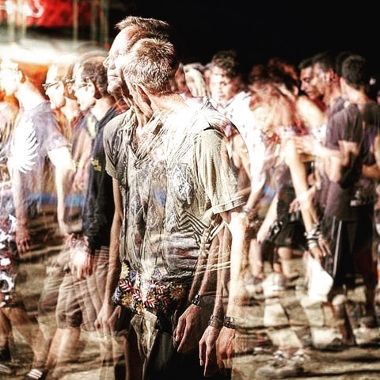

Slide 10
How does this relate to
Advanced Integrative Energy Healing™?
©Kate Shelest 2018

Slide 11
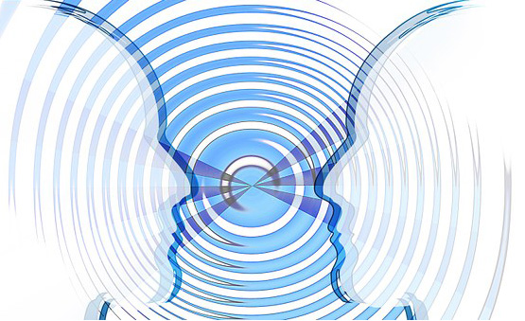
ENTRAINMENT
©Kate Shelest 2018

Slide 12
Entrainment or Sync
EXAMPLES
Heart and brain waves become phase and frequency synchronized with the earth's geoelectric micro pulsations – Schumann resonance (per Robert Beck)
(Oschman 2016, p.260; Brennan 1993, p.17)
Energy Healing practices’ similarities:
noted “periodic entrainments of brain waves and whole-body biomagnetic emissions with the Schumann resonances in the earth’s atmosphere” (Oschman, 2000, p.109).
Measurable (ECG/EKG), between person cardiac – brain wave synchronization (Oschman, 2000, p.108)
NOTE: Geomagnetic pulsations do not impact everyone in the same way.
There is also synchronicity ebb and flow: due to atmospheric/environmental electromagnetic phenomenon and circumstances.
©Kate Shelest 2018

Slide 13
Cont. …
“All of these rhythms – from those taking place at the celestial
scale to those in our organs tissues cells and molecules – have
significance for the health functioning of the human body.
All of them are capable of entraining with each other. Rhythms
In one person can entrain rhythms in another without touching”
(Oschman, 2016, p. 244)
©Kate Shelest 2018

Slide 14
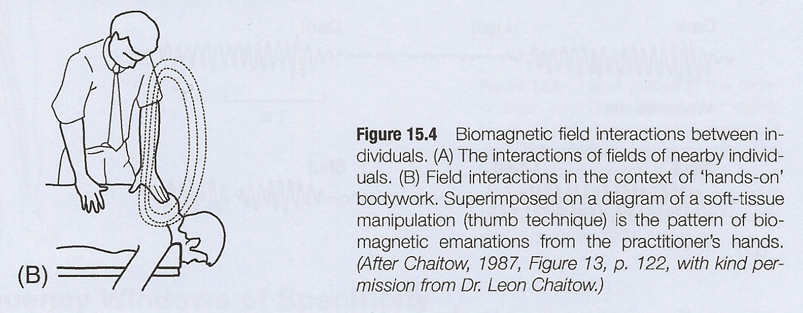
Biomagnetic interactions between individuals (Oschman, 2016, p. 245)
©Kate Shelest 2018

Slide 15
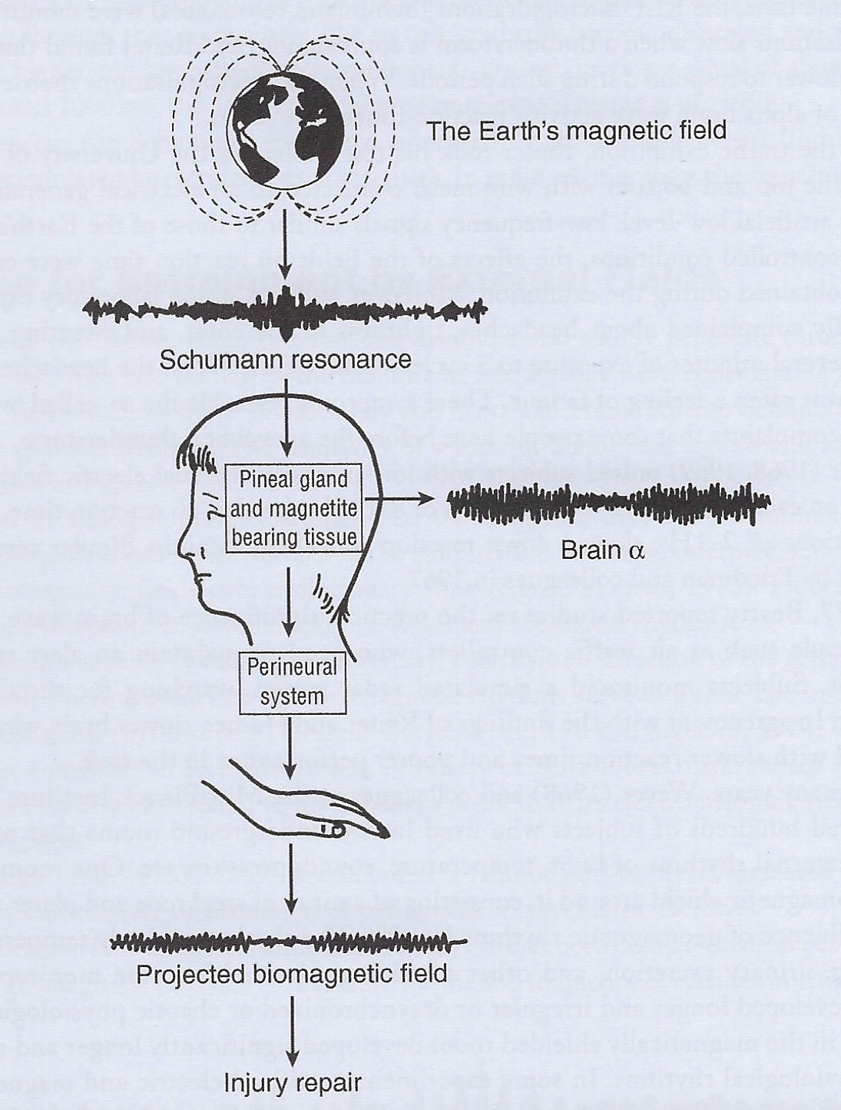
Connection Between Practitioner and Client
“It is fascinating that practitioners of Therapeutic Touch and related methods seem to produce measurable biomagnetic fields that are not steady in frequency.
The emitted field appears to sweep or scan through a variety of frequencies in the ELF range (see Figure 15.8). This is the same range of frequencies that biomedical researchers are finding effective for jump-starting a variety of soft and hard tissues.”
(Oschman, 2016, p. 263)
Summary of proposed pathways involved in magneto reception, the regulation of brain
waves and therapeutic emissions from the hands of therapists. (Oschman, 2016, p. 262)
©Kate Shelest 2018
Notes:
Refer to bone repair article
Peri-neural nervous system reference: explain the difference between neural: (point to point) and peri neural (global wave form to all systems and edges of body)

Slide 16
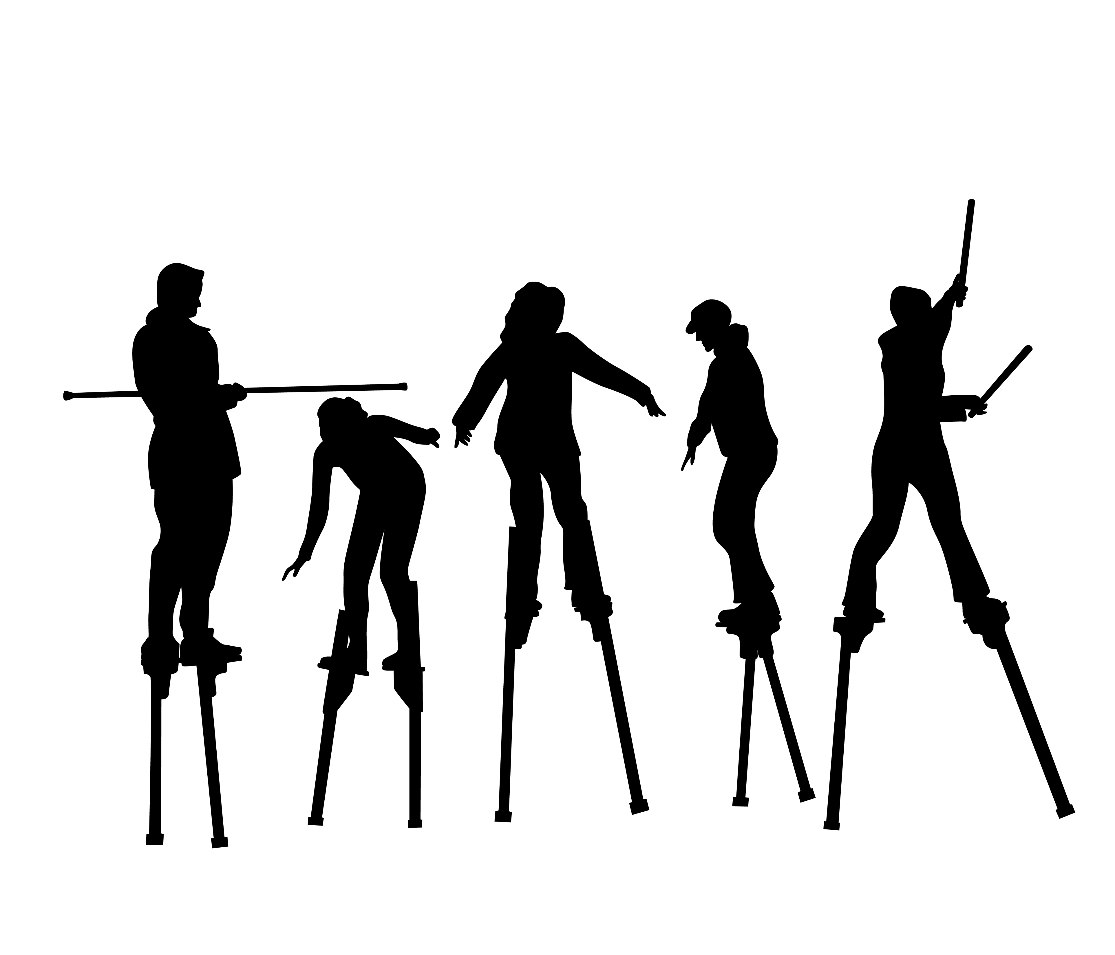
GOAL:
Balance and Coherence
©Kate Shelest 2018

Slide 17
Coherence
Internal multi system oscillations in balance: chemical, cellular, electromechanical
These oscillations may be sensed by practitioners.
“Calm, peaceful and harmonious”
(Oschman, 2000 p. 239)
The work of Frohlich & others:
“Coherent vibrations recognize no boundaries . . . they are collective or
cooperative properties of the entire being.
As such they are likely to serve as signals that integrate processes, such as
growth, injury repair, defense and the function of the organism as a whole.”
(Oschman, 2016, p.181)
“Living Matrix” theory allows us to work with one imbalance/area/frequency
with the potential to impact the other systems
of the matrix e.g. physically & subtly.
©Kate Shelest 2018

Slide 18
The Living Matrix as a Vehicle for Healing
James Oschman on the Living Matrix
(Oschman, 2011)
The ‘living matrix’ provides a vehicle for intentional
attunement & entrainment with clients for the purposes
of healing.
©Kate Shelest 2018

Slide 19
SUPPORTING COHERENCE
AIEH™ practices to repair & balance the Biofield include
Wave Modulation techniques that support ‘Coherence’
Example: Push Pull Allow & Stop
These are basic techniques for activation and development of the
life force energy channels between your hands.
Notice & Sense the energy flow ‘external’ and ‘internal’.
These techniques can be developed for advanced clearing work.
(adapted from Hagglund, 2018, p. 44)
Note: further techniques for repair and balance of the Biofield will be taught in this course.
©Kate Shelest 2018

Slide 20
GROUNDING
The Earth carries an electric negative field charge that is constantly flowing. Grounding is entraining with the frequency of the earth (Schumann Resonance)
To ground yourself means to fully connect:
We allow ourselves to be here and fully present with our physical bodies
NOTICE
How you feel when you are actively grounding.
NOTICE
The difference in sensations related to grounded and un-grounded states.
Practice Practice Practice
Grounding can be difficult for anyone who does not feel safe
Grounding is the perfect remedy when stressed, triggered, regressed, rushed, overworked, confused, panicked, angry, overwhelmed, clumsy or drained
(adapted from Hagglund, 2018, p. 44)
©Kate Shelest 2018

Slide 21
ATTUNING
We learn to attune to the universal energy frequency, experiencing
spiritual and psychic entrainment
(Hagglund, 2018, p. 35)
When hands and heart are properly connected, outward flow of heart chakra
energy can be controlled by your hands.
With this proper connection we are better able to control the flow of energy for healing
(Hagglund, 2018, p. 40)
NOTICE
What do you feel when you are actively attuning with your client.
NOTICE
The difference in sensations of connection vs disconnection.
Practice Practice Practice … with Intention
©Kate Shelest 2018

Slide 22
Intention
Particular emotional states have been correlated with measurable changes in the electrical energy spectrum of the heart
(Oschman, 2000, pp. 237-38)
Mutual development of ‘anticipatory fields’
created through mental imagery and intention is just as valuable to the healing process as the
entrainment of electrical & magnetic rhythms from therapist to client.
(Oschman, 2000, pp. 226 -229)
(Oschman, 2000, p.238)
©Kate Shelest 2018
Notes:
More in Mod 2

Slide 23
Wave Forms & Modulation
PRACTICE IMPLICATIONS
Do not intentionally work with someone’s field if you are unwell
Be aware of the environment around you e.g. minimize biomagnetic sources
Maintain strong grounding and energetic alignment; re-ground if needed
Ask permission
It’s OK to energetically disconnect if you experience discomfort
Disconnect when treatment is completed; avoid entanglement
DISCUSSION
©Kate Shelest 2018

Slide 24
Paradigm Shifts = Research
“Biofield science is an emerging field of study that aims to provide a scientific foundation for understanding the complex homeodynamic regulation of living systems.”
(Rubik, Muehsam, Hammerschlag & Jain, 2015, p. 8)
‘ . . While electromagnetism has been widely studied by physicists, study of biological electromagnetism has just begun . . . “Something has to be added to the laws of physics and chemistry before the biological phenomena can be completely understood”.’
(Oschman, 2000, p. 219)
©Kate Shelest 2018

Slide 25
REFERENCES
Brennan, B. (1993). Light emerging. The journey of personal healing.
New York: Bantam Books.
Byrnes, L. (2018). Advanced integrative energy healing-Healing science-biofield
healing and wave modulation set #1. February 2, 3, & 4/18[PowerPoint slides].
Hagglund, M. (2018). Integrative energy healing intensive Healing science –
energy awareness. Fall 2018[PowerPoint slides].
Oschman, J. L. (2000). Energy medicine, the scientific basis. London UK: Elsevier Ltd.
Oschman, J. L. (2011). The living matrix, consciousness and health. Retrieved from
https://www.youtube.com/watch?v=kSBAJxSirh4
Oschman, J. L. (2016). Energy medicine, the scientific basis, 2nd Ed. London UK:
Elsevier Ltd.
Rubik, B., Muehsam, D., Hammerschlag, R., & Jain, S. (2015). Biofield Science and
Healing: History, Terminology, and Concepts. Global advances in health
and medicine, 4(Suppl), 8-14.
©Kate Shelest 2018

